Slide 1
Scientific figures seminar – Part 1
William F. Lamb
Jérôme Hilaire

Slide 2
Organisation
General principles for making figures (Will, 20 mins)
Practical introduction to Inkscape (Jerome, 20 mins)
Discussion (20 mins)
Hang around after if you want specific help

Slide 3
General principles (what we have learned*)
Identify a key message, communicate it:
  Base graph selection
  Layout and storytelling
  Colour
  Icons
  Simplify
All resources and examples here: https://github.com/mcc-apsis/figures/tree/master/Resources
* Caveat: we are still learning!

Slide 4
Choose the right base graph

Slide 5
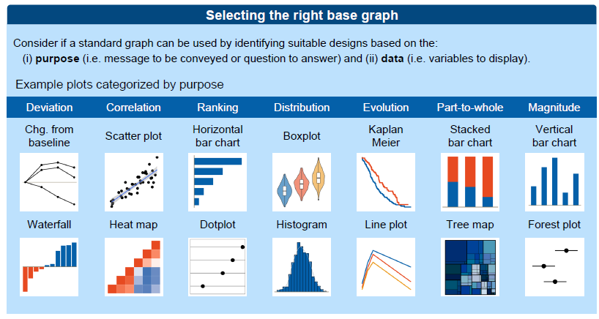
Base graph selection: quantitative
Resources
  Cheat Sheet: https://github.com/mcc-apsis/figures/blob/master/Resources/Readings/CheatSheet.pdf
  Visualisation catalogue: https://datavizcatalogue.com/search.html
  And another: http://textvis.lnu.se/

Slide 6
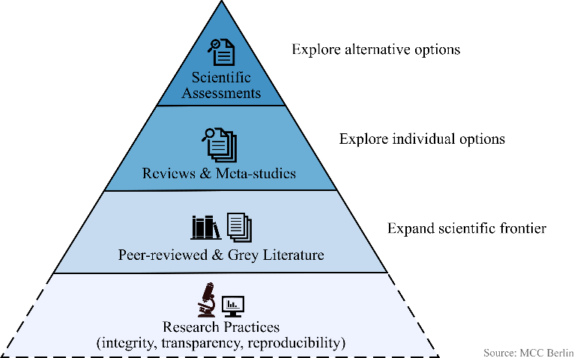
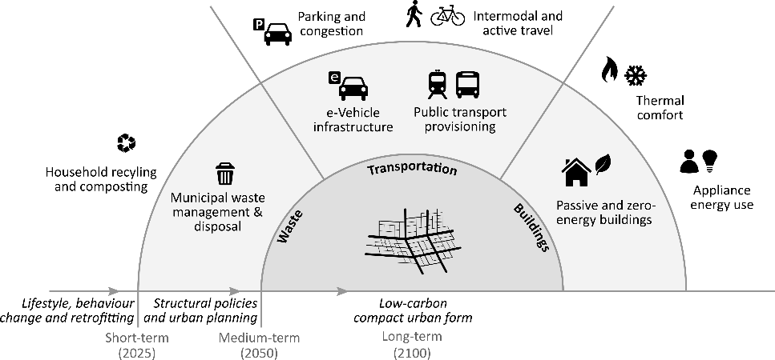
Base graph selection: qualitative
No rules!
Flow diagrams, Venn diagrams are common
Use shapes?

Slide 7
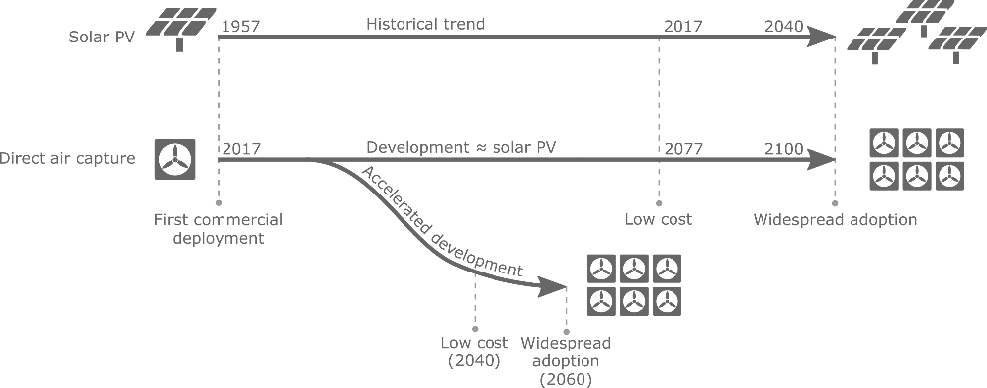
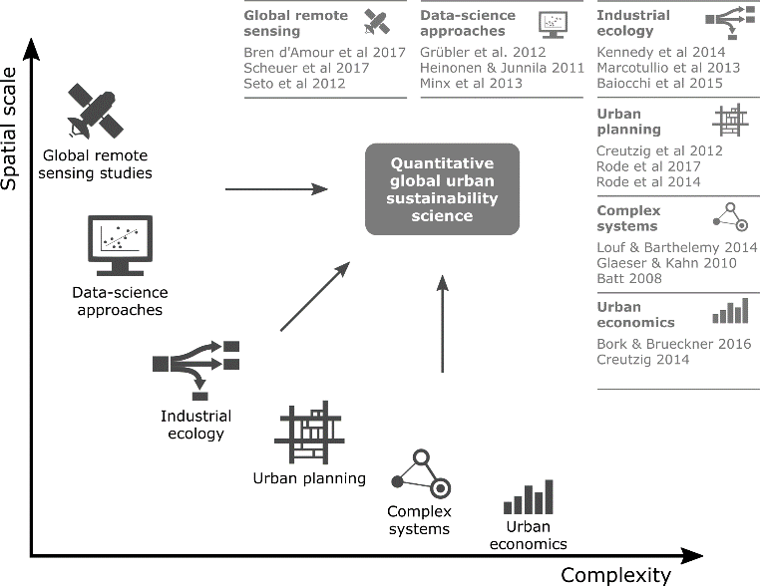
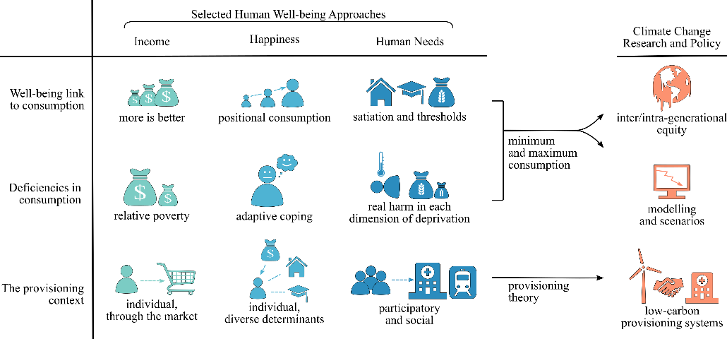
Base graph selection: qualitative
Use scientific forms: axes, tables, etc.

Slide 8
Use layout and tell a story

Slide 9
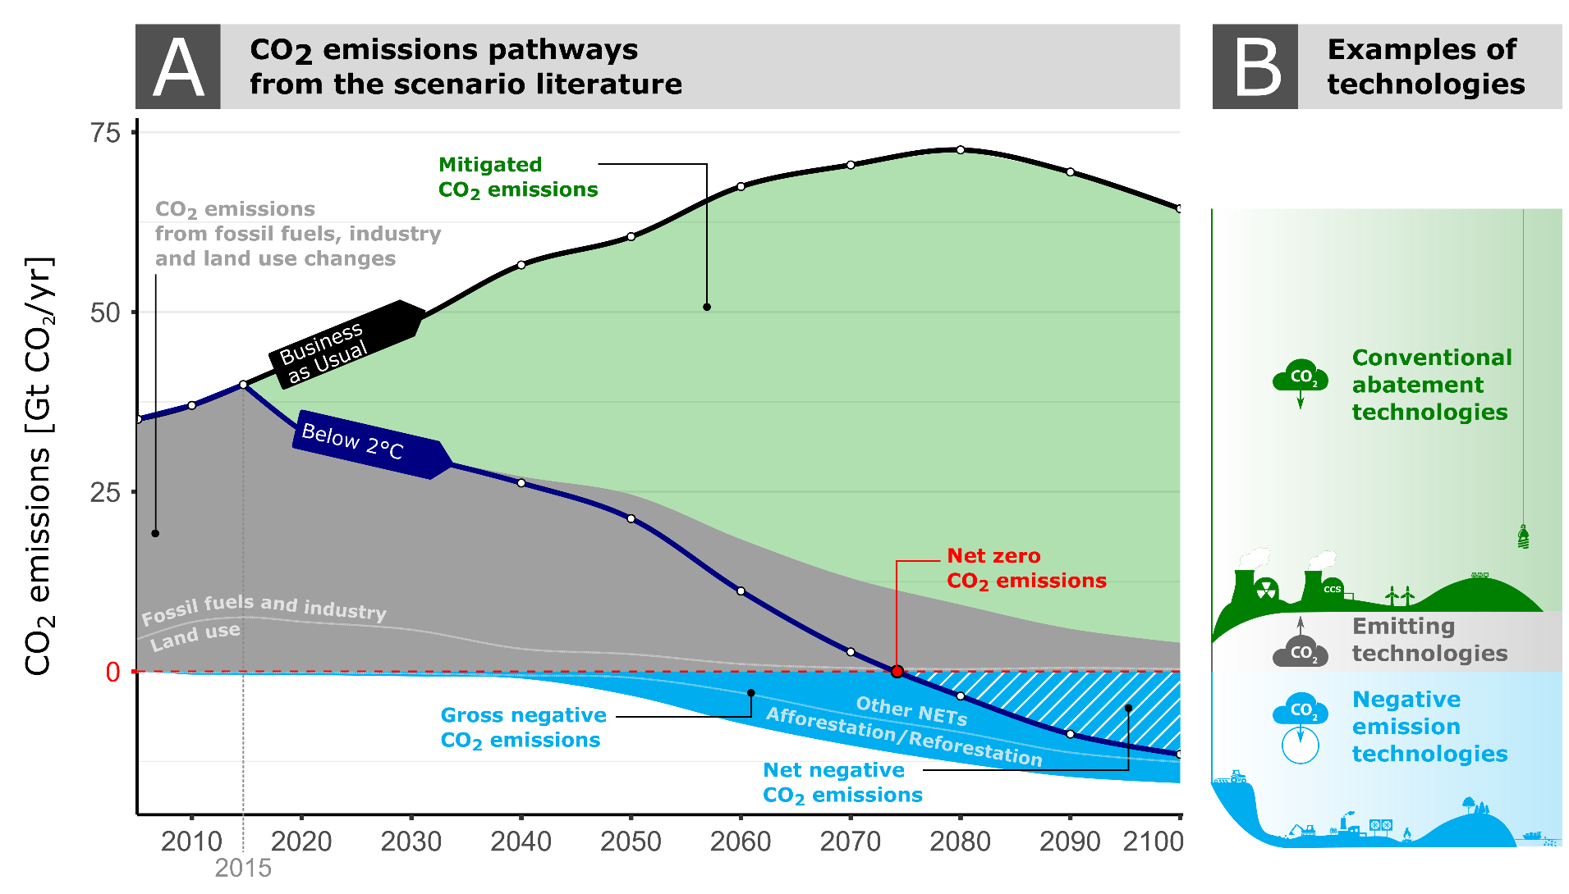
Layout and storytelling
Divide into parts, annotate

Slide 10
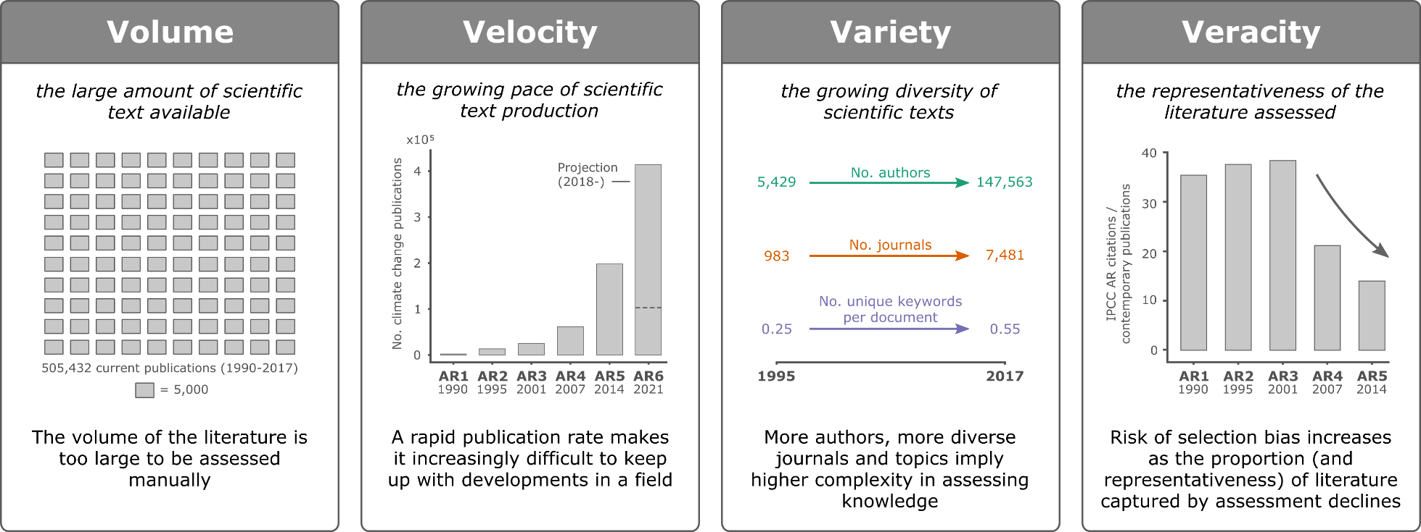
Layout and storytelling
Repetition

Slide 11
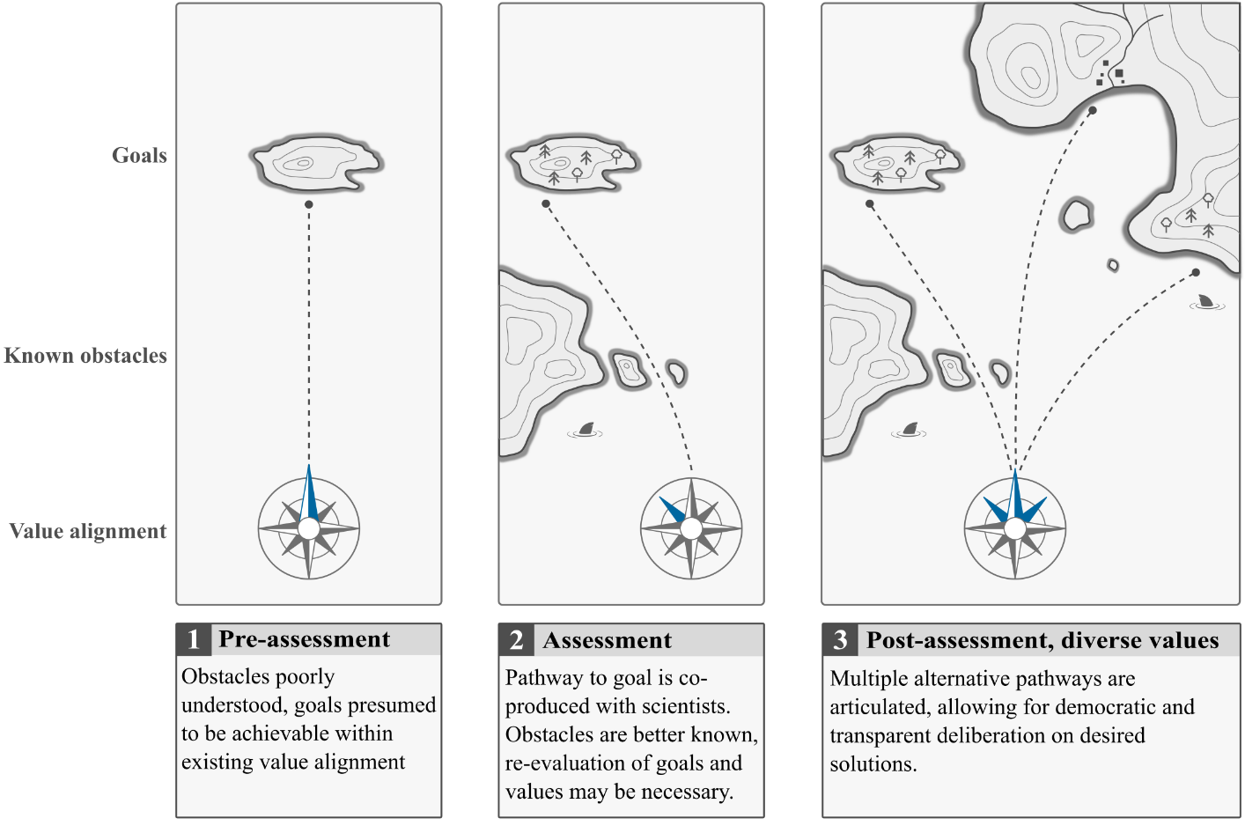
Layout and storytelling
Sequences

Slide 12
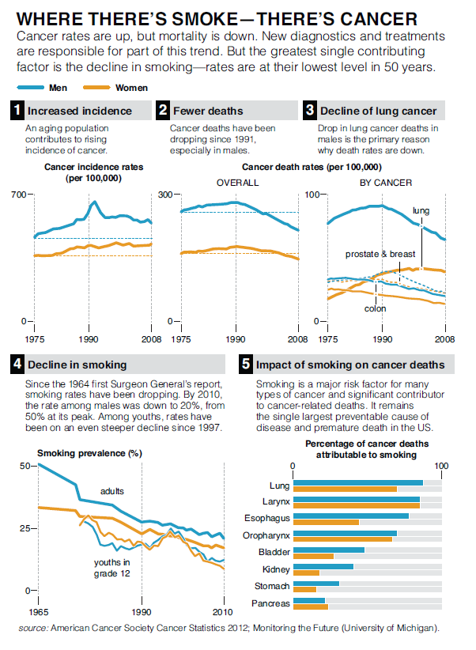
Layout and storytelling
Sequences

Slide 13
Use colour

Slide 14
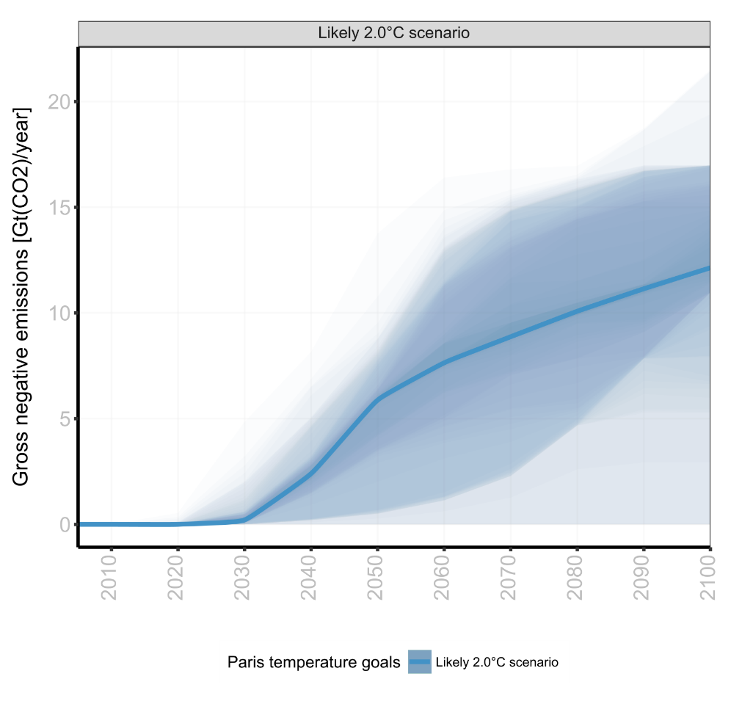
Colour
For emphasis

Slide 15
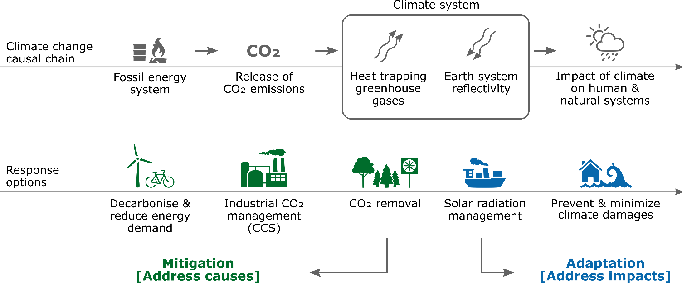
Colour
For distinction

Slide 16
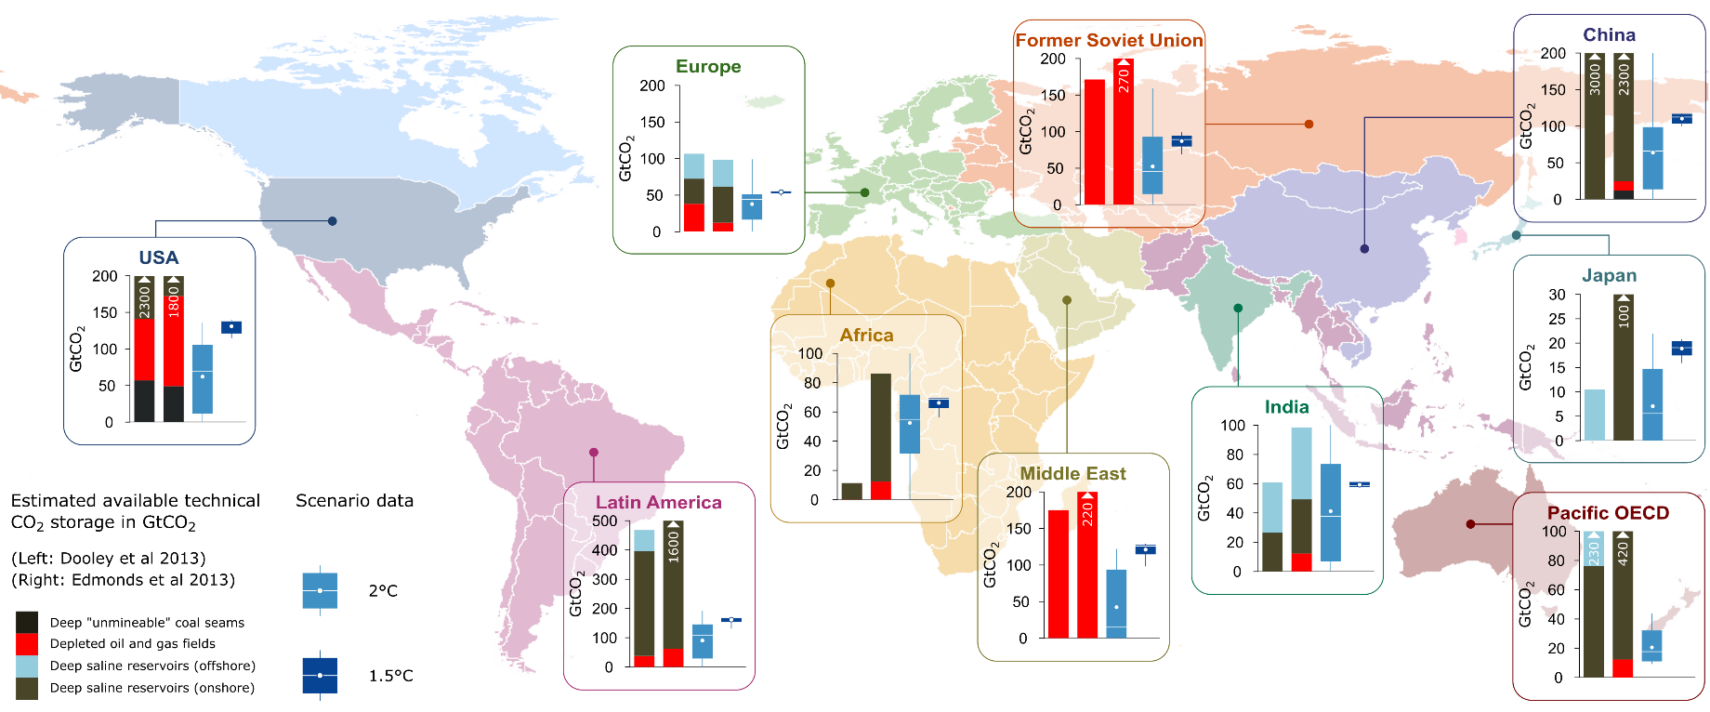
Colour
For distinction

Slide 17
Colour
Avoid defaults (rainbow, jet)
Be aware of colour blindness
Use colorbrewer2.org (also via libraries in python/r)
Plenty of discussions
  https://blog.datawrapper.de/colors/
  http://www.visualisingdata.com/2015/01/make-grey-best-friend/

Slide 18
Use icons

Slide 19
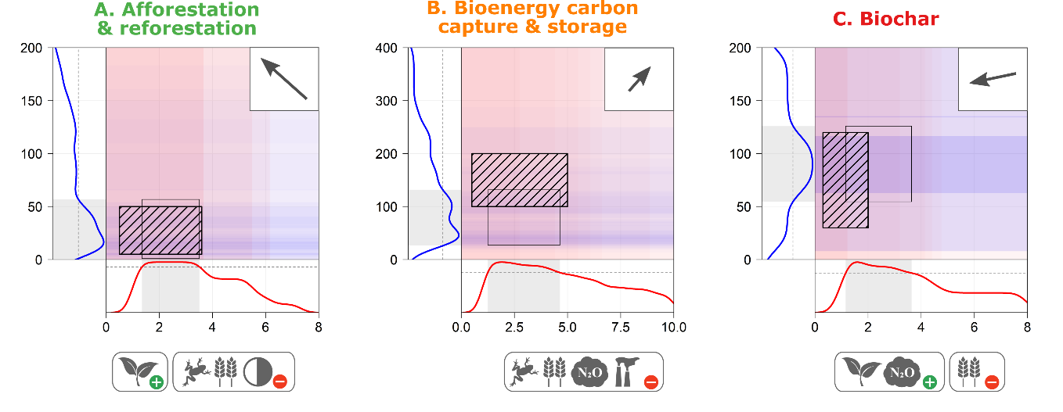
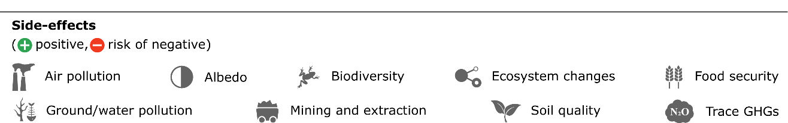
Icons
For concise labelling

Slide 20
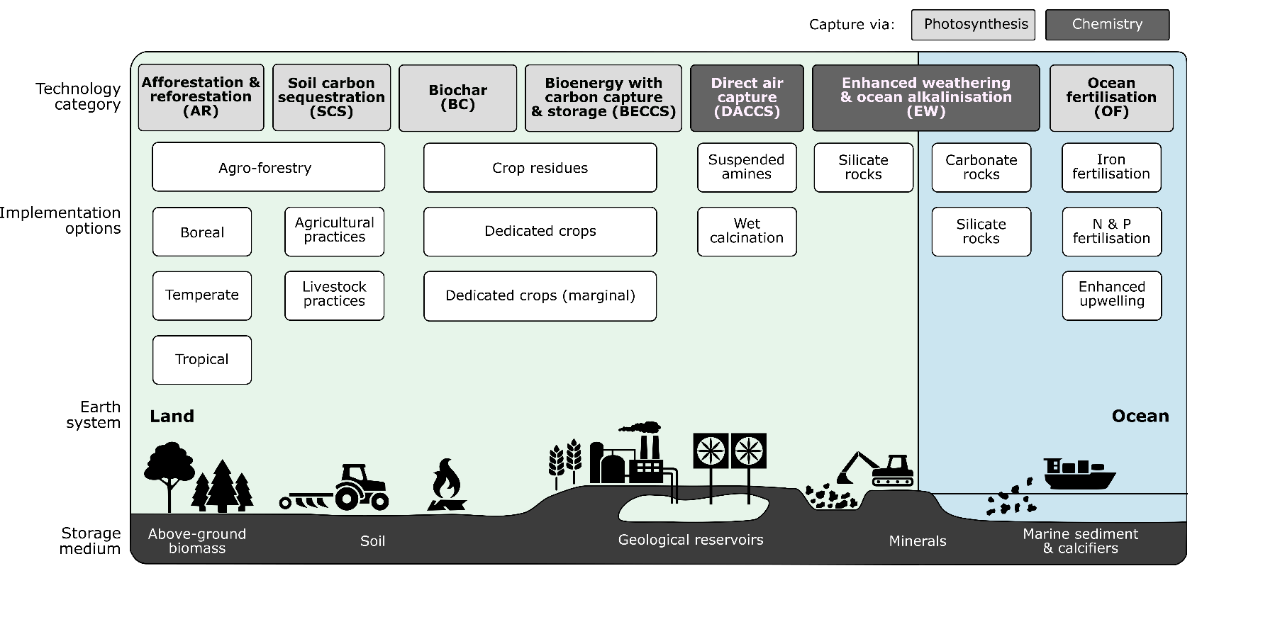
Icons
For jazzing up boring stuff?

Slide 21
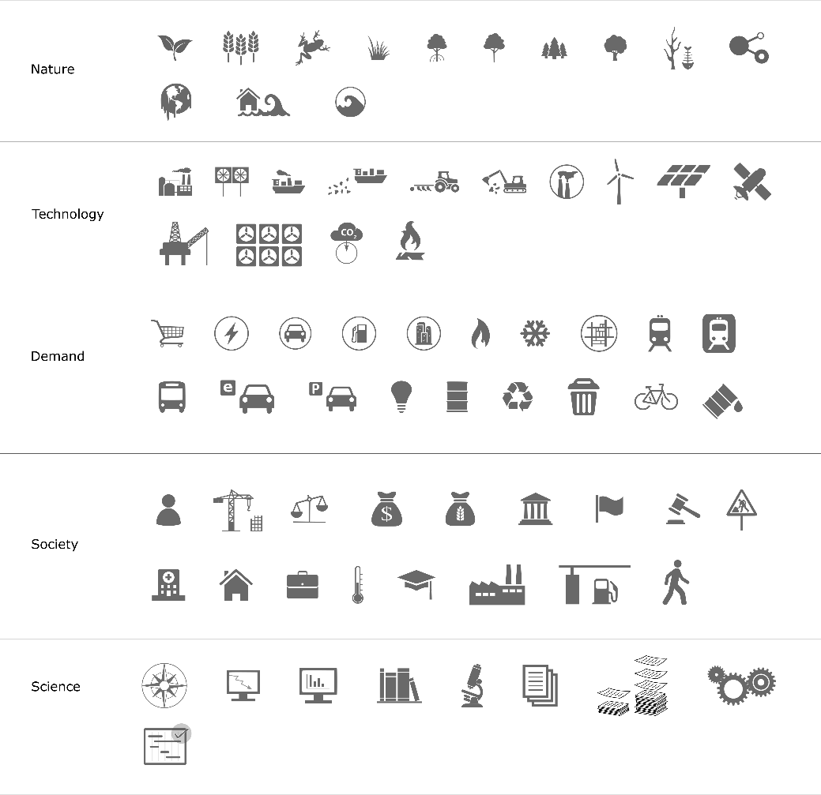
Icons
Our library: https://github.com/mcc-apsis/figures/tree/master/Resources/Small%20icons
Open license library: https://thenounproject.com/

Slide 22
Simplify

Slide 23
Simplify
Remove or mute colours, backgrounds, borders
Avoid angled and vertical text
Avoid overlapping parts
Arrows for causal relationships ( ), circles for labelling ( )
Be consistent (font, style)
Remove to improve
https://www.darkhorseanalytics.com/blog/data-looks-better-naked
https://www.darkhorseanalytics.com/blog/clear-off-the-table

Slide 24
What role do negative emissions play in 2oC scenarios?

Slide 25
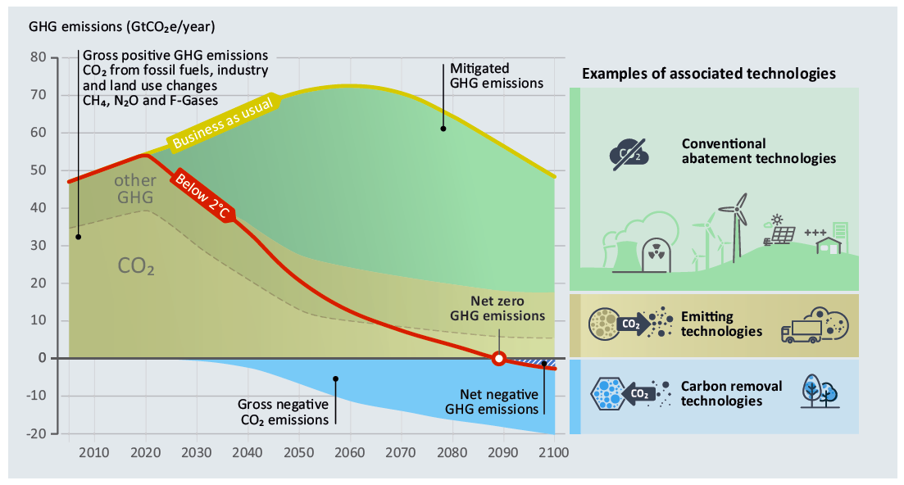

Slide 26
Thanks
& please add to our resources:
Articles and papers
Example figures

